Slide 2
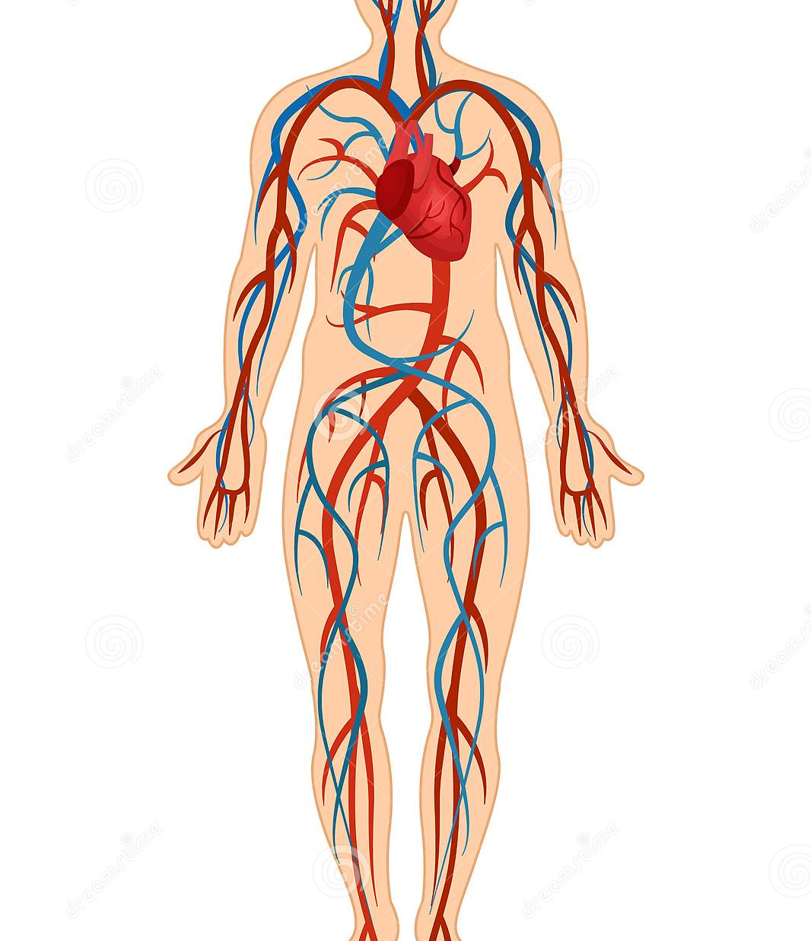
Human circulatory system

Slide 3
Parts of the circulatory system

Slide 4
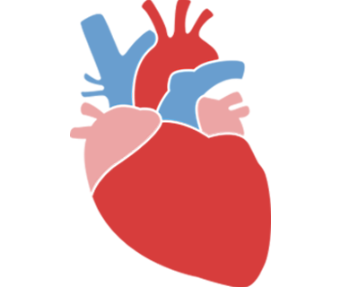
The Heart

Slide 5
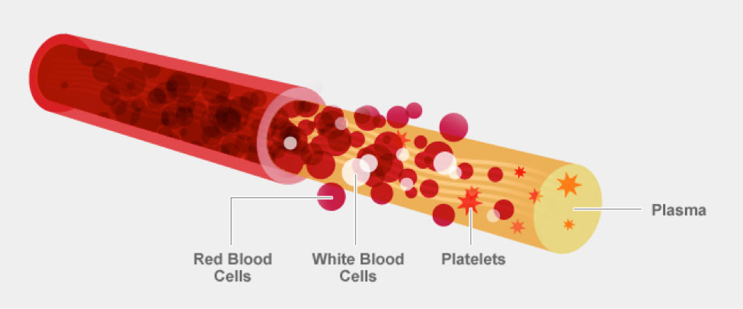
Blood

Slide 6
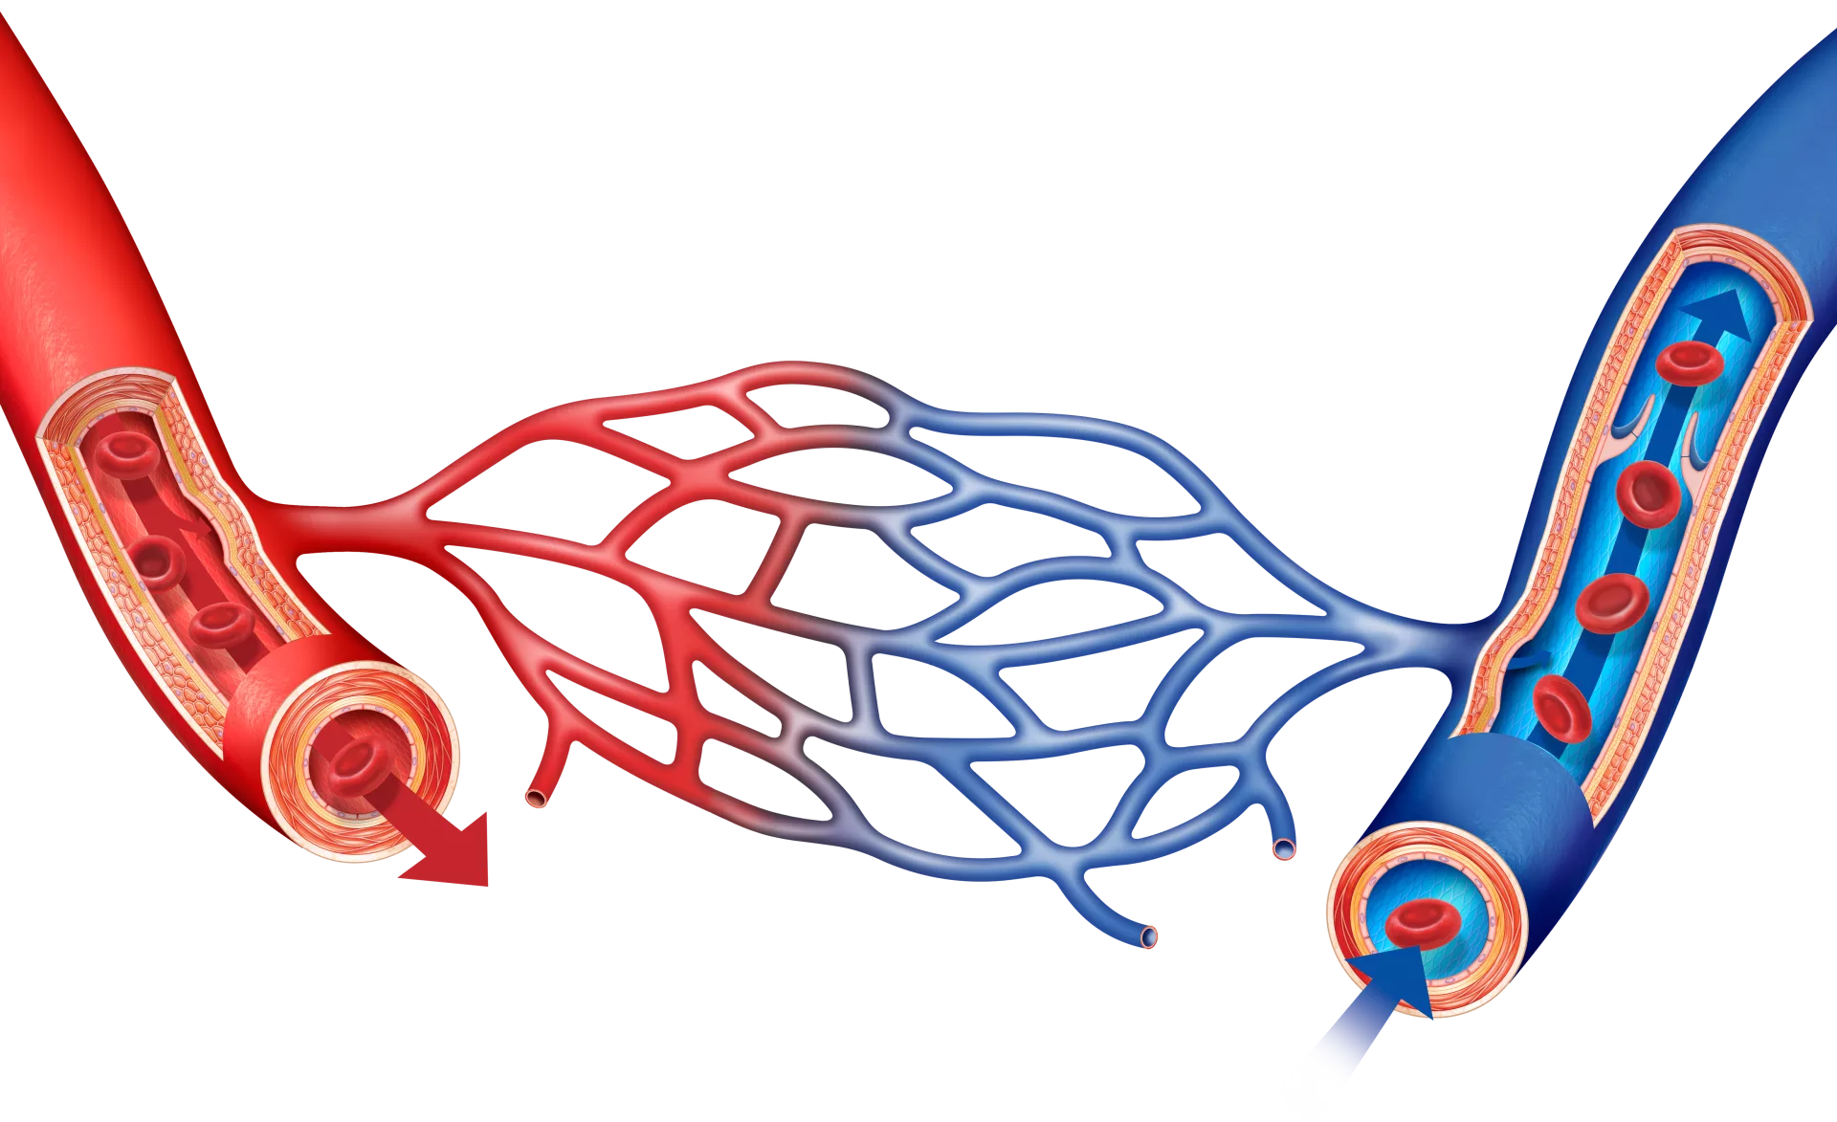
Blood Vessels

Slide 7
Blood components and their functions
Blood components include:
Plasma
Red blood cells
White blood cells
White blood cells
platelets

Slide 8
Plasma
Carry digested food substances to the body organs and carbon dioxide to the excretory organs
Also carry red and white blood cells

Slide 9
Red blood cells
They carry oxygen (through a red coloring substance called haemoglobin)
The blood mixed with haemoglobin is called oxy-haemoglobin
Blood rich in oxygen is bright red; white de-oxygenated blood is dark red

Slide 10
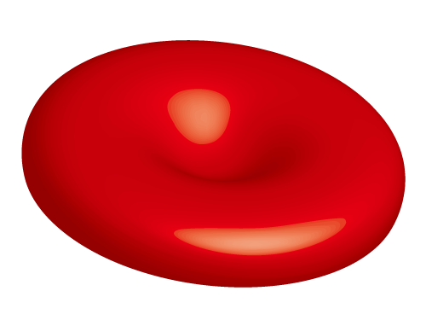
Characteristics of Red Blood Cells
They’re biconcave in shape
They do not have a nucleus
Their life span is very short only 120 days
They’re made in the red bone marrow and destroyed in the liver and in the spleen
They carry oxygen from the lungs to the body tissues
They are broken down in the spleen and in the liver
Ration of red blood cell to white blood cells is 600:1

Slide 11
White blood cells
They fight germs (disease causing organisms)

Slide 12

Characteristics of white blood cells
Are colorless and have a nucleus
Are irregular and keep changing shape
They either eat the germ by engulfing or digesting them
They are larger than red blood cells
They are made in the bone marrow, spleen and lymph nodes
They are about 600 red blood cells in one white blood cell

Slide 13
Platelets
Platelets help in blood clotting when one gets injured
As the blood clot it stops further bleeding
They are oval in shape

Slide 14
The following are functions of the blood
Transport digested food from small intestine to the other body parts
Distribute heat throughout the body
Transport oxygen from the lungs to the other body parts
Transport carbon dioxide from the other body parts to the lungs
Help to defend our body against diseases
To remove waste products from other body parts to the kidney

Slide 15
Blood vessels
The blood vessels are a part of the circulatory system that transports blood throughout the human body. These vessels are designed to transport nutrients and oxygen to the tissues of the body. They also take waste and carbon dioxide and carry them away from the tissues and back to the heart. Blood vessels are needed to sustain life as all of the body’s tissues rely on their functionality.
There are three major types of blood vessels: the arteries, the capillaries and the veins

Slide 16
Arteries
Arteries have thick walls, are muscular and elastic
All arteries except pulmonary artery carry oxygenated blood
Their structure enables them to withstand high blood pressure
Pulmonary artery carry deoxygenated blood from the heart to the lungs

Slide 17
Function of arteries
Arteries carry oxygenated blood from the heart to all other parts of the body except the pulmonary artery which carries deoxynated blood from the heart to the lungs
The main artery is the aorta

Slide 18
Veins
Veins have thinner walls than arteries
Blood in the veins flow at a lower pressure than in the arteries
Veins carry blood to the heart
NOTE
Veins have valves to prevent blood flowing backwards
All veins except the pulmonary vein carry oxygenated blood from the lungs to the heart

Slide 19
Functions of the veins
Carry deoxygenated blood from the body organs to the heart, except the pulmonary vein which carries oxygenated blood from the lungs to the heart
The main vein is the venacava

Slide 20
Comparison between arteries and veins
Arteries
Veins
They carry blood away from the heart
They have no valves
Are deep seated
Have impulse
Have thick and elastic walls
Carry blood in high pressure
They carry oxygenated blood except pulmonary artery
They carry blood to the heart
They have valves
Are often superficial
Have no impulse
Have thin walls
Carry blood in low pressure
Carry deoxygenated blood except pulmonary vein

Slide 21
Capillaries
They are the smallest blood vessels in the body
They are tiny and thin
They are non-elastic
They carry blood to all the body tissues
They are the most abundant components

Slide 22
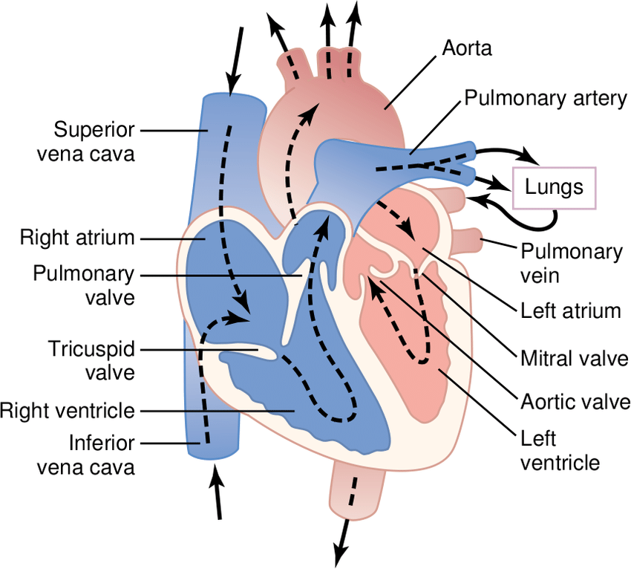
Structure of the heart

Slide 23
The heart has four chambers
Right ventricle
Right auricle
Left ventricle
Left auricle

Slide 24
Right auricle
Thin walled
Receive blood from the body parts

Slide 25
Left auricle
Thin walled
Receive blood from the lungs

Slide 26
Right ventricle
Thick walled
Pumps blood to the lungs

Slide 27
Left ventricle
Thick walled
Pumps blood to the body parts

Slide 28
Note
Chambers usually contracts and relax as they pump blood, forming heartbeat
Heart beats are known as pulse
Pulse (heartbeat) is felt above the artery in the wrist
Stethoscope is used in the hospital to hear the heartbeats
In adult under normal conditions, the heart beats about 72 times per minute

Slide 29
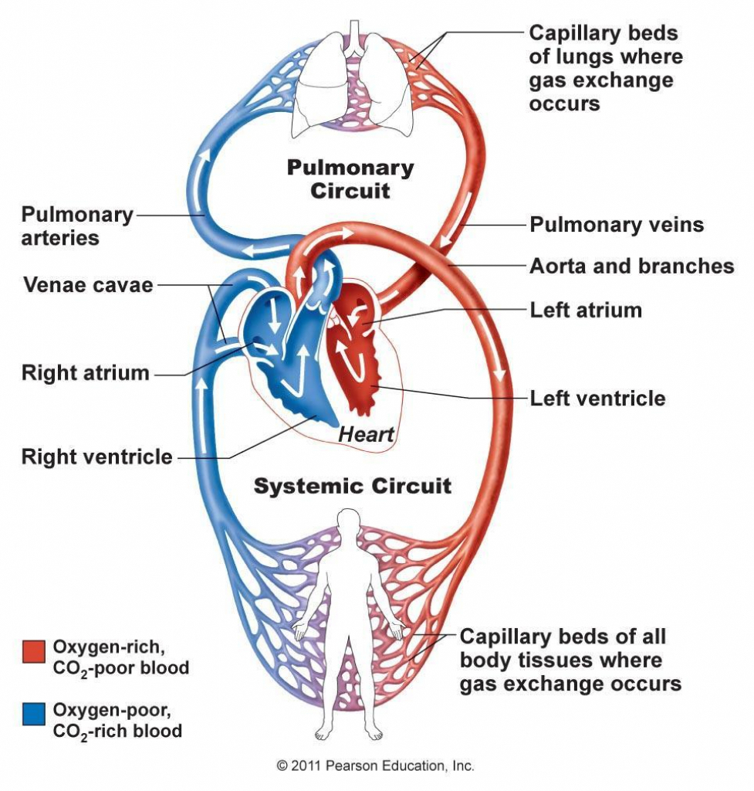
Summary of the circulation of blood

